Slide 1
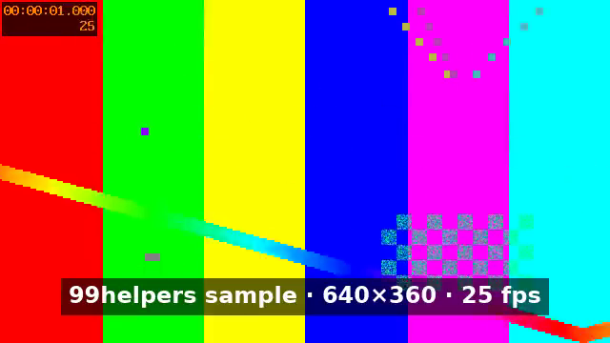
An embedded video
A 4-second H.264 + AAC MP4, stored in ppt/media/ with a PNG poster frame. Click to play.
Notes:
Video is embedded in the package. In the old .ppt format, video could only be linked.

